Slide 1
Minimum Spanning Trees
CONTENTS
Introduction to Minimum Spanning Trees
Applications of Minimum Spanning Trees
Optimality Conditions
Kruskal's Algorithm
Prim's Algorithm
Sollin's Algorithm
Reference: Sections 13.1 to 13.6

Slide 2
Introduction to Minimum Spanning Tree
Given an undirected graph G = (N, A) with arc costs
(or lengths) c_{ij}’s.
A spanning tree T is a subgraph of G that is
  a tree (a connected acyclic graph), and
  spans (touches) all nodes.
Every spanning tree has (n-1) arcs.
Length of a spanning tree T is ∑_{(i,j)∈T} c_{ij.}
The minimum spanning tree problem is to find a spanning tree of minimum cost (or length).
10
2
10
4
2
4
35
35
25
1
25
20
30
1
20
30
40
40
5
3
15
5
3
15

Slide 3
Applications
Construct a pipeline network to connect a number of towns using the smallest possible total length of the pipeline.
Connecting terminals in cabling the panels of an electrical equipment. How should we wire terminals to use the least possible length of the wire?
Connecting different components of a digital computer system. Minimizing the length of wires reduces the capacitance and delay line effects.
Connecting a number of computer sites by high-speed lines. Each line is leased and we want to minimize the leasing cost.
All-pairs minimax path problem.

Slide 4
Properties of Minimum Spanning Trees
₂
₂₀
₄
₁₀
₃₀
₁₅
₄₀
₁
₃₅
₆
₂₅
₂₀
₃
₃₅
₅
Is the above spanning tree a minimum spanning tree?
Can we replace a tree arc with an appropriate nontree arc and reduce the total cost of the tree?
For a given nontree arc, what tree arcs should be considered for replacement?
For a given tree arc, what nontree arcs should be considered for replacement?

Slide 5
Notation
₂
₂₀
₄
₁₀
₃₀
₁
₁₅
₄₀
₃₅
₆
₂₅
₂₀
₃
₃₅
₅
For any nontree arc (k, l), let P[k, l] denote the unique tree path from node k to node l.
P[3, 5] : 3-1-2-4-5
P[5, 6] : 5-4-6
P[2, 3] : 2-1-3
For any tree arc (i, j), let Q[i, j] denote the cut formed by deleting the arc (i, j) from T.
  Q[1, 2] : {(1, 2), (3, 2), (3, 5)}
  Q[1, 3] : {(1, 3), (3, 2), (3, 5)}
  Q[2, 4] : {(2, 4), (2, 5), (3, 5)}

Slide 6
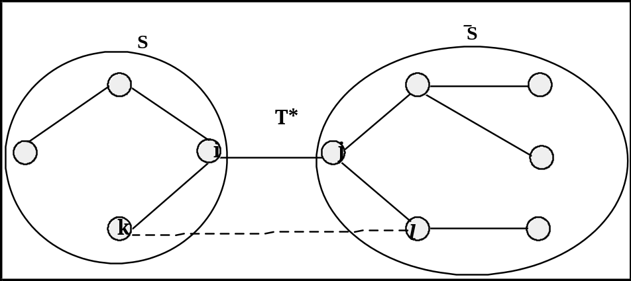
Cut Optimality Conditions
Theorem: A spanning tree T* is a minimum spanning tree if and only if for every tree arc (i, j), it satisfies the following cut optimality conditions: c_{ij} ≤ c_{kl} for every arc (k, l) ∈ Q[i, j].
NECESSITY. If c_{ij} > c_{kl}, then replacing arc (i, j) by (k, l) in T* gives another spanning tree of lower cost, contradicting the optimality of T*.
SUFFICIENCY. Let T* be a minimum spanning tree, and T⁰ be a spanning tree satisfying cut optimality conditions. We can show that T* can be transformed into T⁰ by performing a sequence of arc exchanges that do not change the cost.

Slide 7
Path Optimality Conditions
Theorem: A spanning tree T* is a minimum spanning tree if and only if for every nontree arc (k, l), it satisfies the following path optimality conditions: c_{ij} ≤ c_{kl} for every arc (i, j) ∈ P[k, l].
NECESSITY. If c_{ij} > c_{kl}, then replacing arc (i, j) by (k, l) in T* gives another spanning tree of lower cost, contradicting the optimality of T*.
SUFFICIENCY. Show that the cut optimality conditions are satisfied if and only if the path optimality conditions are satisfied.

Slide 8
Byproduct of Path Optimality Conditions
₂
₂₀
₄
₁₀
₃₀
₁₅
₄₀
₁
₃₅
₆
₂₅
₂₀
₃
₃₅
₅
A Simple Algorithm:
Replace a lower cost nontree arc with a higher cost tree arc. Repeat until no such pair of arcs remains.
Time per iteration: O(nm)
Number of iterations: O(m²)
Total time: O(nm³)

Slide 9
Kruskal’s Algorithm
Sort all arcs in the non-decreasing order of their costs.
Set T* = ϕ, a tree null.
Examine arcs one-by-one in the sorted order and add them to T* if their addition does not create a cycle.
Stop when a spanning tree is obtained.
The spanning tree T* constructed by Kruskal's algorithm is a minimum spanning tree.

Slide 10
Kruskal’s Algorithm
10
2
10
4
2
10
4
2
4
35
35
35
25
1
25
20
30
1
25
20
30
1
20
30
40
40
40
3
5
3
15
5
3
15
5
15
2
10
4
2
10
4
2
10
4
35
35
35
1
25
20
30
1
25
20
30
1
25
20
30
40
40
40
3
15
5
3
15
5
3
15
5

Slide 11
Kruskal’s Algorithm
BASIC OPERATIONS:
  Maintain a collection of subsets
  Find operation: Find whether the subsets containing nodes i and j are the same or different. There are m find operations.
  Union operation: Take the union of the subsets. There are at most (n-1) union operations.
  There exist union-find data structures which allow each union and each find operation to be performed in
  O(log n) time.
RUNNING TIME: O(m log n)

Slide 12

Prim’s Algorithm
This algorithm is a by-product of the cut optimality conditions and in many ways, it is similar to Dijkstra's shortest path algorithm.
Start with S = {1} and T* = a null tree.
Identify an arc (i, j) in the cut [S, ] with the minimum cost. Add arc (i, j) to T* and node j to S.
Stop when T* is a spanning tree.
The spanning tree constructed by Prim's algorithm is a minimum spanning tree.

Slide 13
Prim’s Algorithm
10
2
10
4
2
10
4
2
4
35
35
35
25
1
25
20
30
1
25
20
30
1
20
30
40
40
40
3
5
3
15
5
3
15
5
15
2
10
4
2
10
4
2
10
4
35
35
35
1
25
20
30
1
25
20
30
1
25
20
30
40
40
40
3
15
5
3
15
5
3
15
5

Slide 14
An Implementation of Prim’s Algorithm
Maintain two labels with each node j: d(j) and pred(j)
d(j) = min{c_{ij} : (i, j) ∈ [S, ]} and pred(j) = {i ∈ S : c_{ij} = d(j)}
algorithm Prim ;
begin
set d(1) : = 0 and d(j) : = C + 1;
for each j ∈ N - {1} do d(j) : = c_{1j};
T*: = φ; S : = {1};
while |T*|< (n-1) do
begin
select a node i satisfying d(i) = min{d(j) : j∉S};
S : = S∪{i} ;T*: = T*∪{(pred(i), i)};
for each (i, j) ∈ A(i) do
if c_{ij} < d(j) then d(j):= c_{ij} and pred(j):= i;
end;
end;
Running Time = O(n²), but can be improved.

Slide 15
Sollin’s Algorithm
This algorithm is also a by-product of the cut optimality conditions.
Maintains a collection of trees spanning the nodes N₁, N₂, ..., N_{k}.
Proceeds by adding the least cost arc emanating from each tree.
Each iteration reduces the number of components by a factor of at least 2.
Each iteration takes O(m) time.
The algorithm performs O(log n) iterations and can be implemented to run in O(m log n) time.

Slide 16
Sollin’s Algorithm
2
10
4
2
10
4
35
35
20
1
25
20
30
1
40
20
3
5
3
15
5
15
2
10
4
35
1
20
3
15
5

Slide 17
All-Pairs Minimax Path Problem
Value of a path: In an undirected network G with arc lengths c_{ij}'s, the value of a path P = max{c_{ij}: (i, j) ∈P}.
Minimax path : A directed path of minimum value.
All-pairs minimax path problem: Find a minimax path between every pair of nodes.
₂₀
₂
₄
₁₀
₃₀
₁₅
₄₀
₁
₃₅
₆
₂₅
₂₀
₃
₃₅
₅

Slide 18
Applications of Minimax Path Problem
While traveling on highways, minimize the length of longest stretch between rest areas.
While traveling in a wheelchair, minimize the maximum ascent along a path.
Determining the trajectory of a space shuttle to minimize the maximum surface temperature.

Slide 19
Algorithm for Minimax Path Problem
₂₀
₂
₄
₁₀
₃₀
₁₅
₄₀
₁
₃₅
₆
₂₅
₂₀
₃
₃₅
₅
THEOREM. A minimum spanning tree T* of G gives a minimax path between every pair of nodes.
PROOF. Take any path P[i, j] in T* from node i to node j. Show that it is a minimax path from node i to node j.

